Slide 1
Lipid Catabolism

Slide 2
Quiz Question #1
How does peroxisomal lipid oxidation differ from mitochondrial lipid oxidation?
Different terminal electron acceptor
Different rate limiting enzyme
Different initial substrate preferences
All of the above
Notes:
D

Slide 3
Quiz Question #2
What does not promote ketogenesis?
Lack of carbohydrates
Prolonged fasting
Reduced lipolysis in adipose tissue
Uncontrolled Type 1 Diabetes
Notes:
C

Slide 4
Quiz Question #3
Which tissue or organ is the most dependent on fatty acid oxidation for normal function?
White adipose tissue
Heart
Brain
Kidneys

Slide 5
Learning Objectives
Explain how triglyceride breakdown into glycerol and free fatty acids is controlled in adipocytes by hormonal signals.
Explain how high carbohydrate diets affect fuel utilization, including effects on lipid fuel utilization. Describe at an endocrine level how this is thought to occur.
Determine how much energy, in ATP equivalents, is released during the oxidation of a given fatty acid. Be able to relate the energy content of a fatty acid, in general to its physical properties (length and saturation).
Explain the rate limiting steps of lipid oxidation.
Explain how ketone bodies are converted to ATP in non-hepatic tissues, and what governs this specificity.
Demonstrate an understanding of how how de novo lipogenesis and b-oxidation are reciprocately controlled.
Describe how very long chain fatty acids are oxidized differently from long chain fatty acids.
Explain how odd-numbered fatty acids are catabolized, including the importance of vitamin B12 in this process.
Evaluate the role of transcriptional regulation and long term adaptations to fatty acid oxidative capacity.

Slide 6
Lipolysis

Slide 7
Why Triacylglycerol Breakdown
Stored as triglycerides, used as fatty acids
Brain and RBC can not utilize lipids as energy source
Hydrolysis of triacylglycerol yields: Glycerol and 3 fatty acids
Notes:
\

Slide 8
Regulation of Lipolysis
Promoted by
Glucocorticoids (transcriptional)
Adrenaline (protein phosphorylation)
Restricted by
Insulin (protein dephosphorylation)

Slide 9
Under What Conditions is DNL Occurring?
Control
High Glucose Overfeeding
High Sucrose Overfeeding
High Glucose, High Energy
Needs lots of Acetyl-CoA/NADPH/ATP
Contribution to overall lipid balance is due to sparing of fat when carbohydrates are present
DNL still very important for fatty liver disease
McDevitt RM, Bott SJ, Harding M, Coward WA, Bluck LJ, Prentice AM. De novo lipogenesis during controlled overfeeding with sucrose or glucose in lean and obese women. Am J Clin Nutr 2001; 74:737–46.

Slide 10
Dual Macronutrient Economy Hypothesis
Preferentially Use Carbohydrates as Fuel if they are present
As a Result Spares Dietary and de novo Fat, mechanisms include:
Prevents beta oxidation
Prevents lipolysis
Proposed as the way that high carbohydrate diets obesity

Slide 11
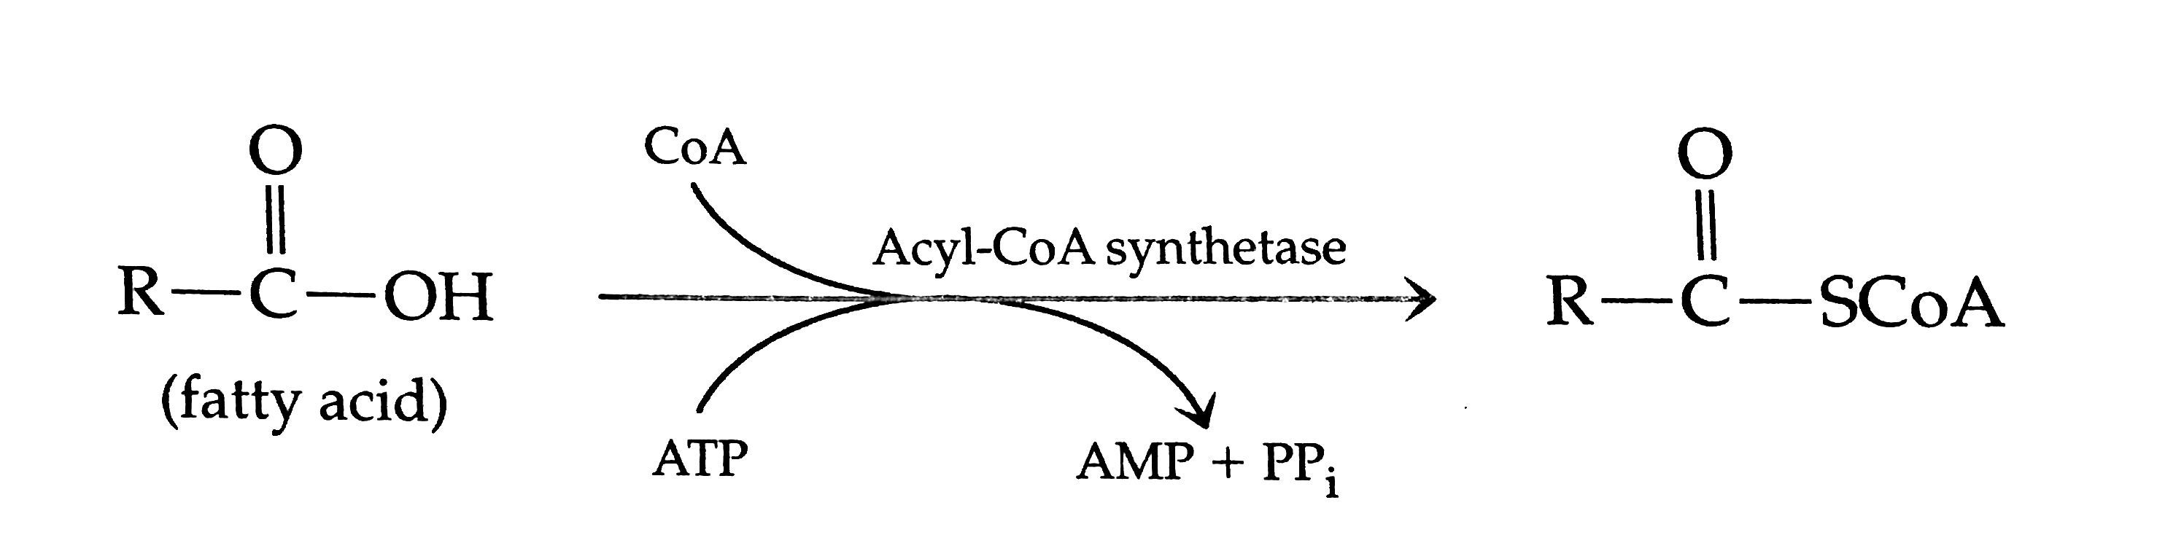
Fatty Acid Activation
Initial reaction converts fatty acid to fatty acid acyl-CoA (cytoplasm) (energy utilization – 2 ATP equivalents)
Fatty acid acyl CoA is transported from the cytoplasm to mitochondria for β-oxidation
Same as initial reaction for triglyceride synthesis

Slide 12
Fatty Acid Transport into Mitochondria
Carnitine transport system:
Uses carnitine as a carrier molecule
Carnitine moves fatty acyl CoA from cytoplasm across mitochondrial membrane to mitochondria

Slide 13
Where does carnitine come from?
Lysine
Arginine
Asparagine
Glutamine
Carnitine deficiencies
Genetically due to reduced transport into cells
1:67,000 individuals
Symptoms
Cardiomyopathy
Hypoketotic hypoglycemia (low ketones and low glucose)
Why?
Notes:
Lysine

Slide 14
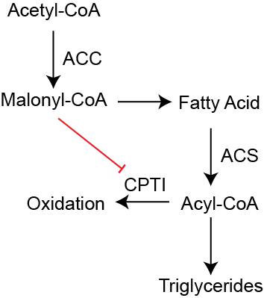
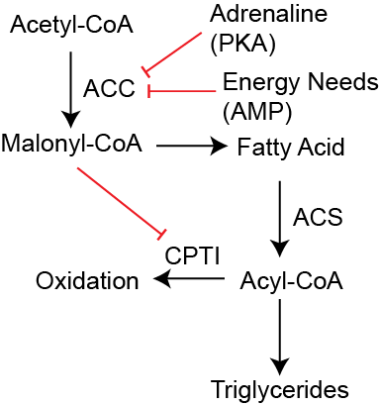
Co-ordinate regulation of lipogenesis and β-oxidation by ACC
The product of the ACC reaction inhibits CPTI
This prevents lipid oxidation while fatty acids are being made
Activated fatty acids (CoA-conjugated) are made into triglycerides
Adrenaline and energy needs inhibit ACC
This prevents Malonyl-CoA production
Activated fatty acids are oxidized

Slide 15
Chronic Regulation of Fatty Acid Oxidation
Peroxisome Proliferator Activating Receptor (PPARα and PPARδ)
Activated by several ligands (PUFAs, eiscosanoids, drugs)
Also increased by exercise (muscle) and increased fat uptake (liver and muscle)

Slide 16
Sequential β-oxidation
Starts at carboxyl end
Each cycle
Generates FADH2
Generates NADH
Generates Acetyl-CoA
Last step has two Acetyl-CoA as products
Notes:
38 per glucose
The 2 is from the activation to Acyl-CoA

Slide 17
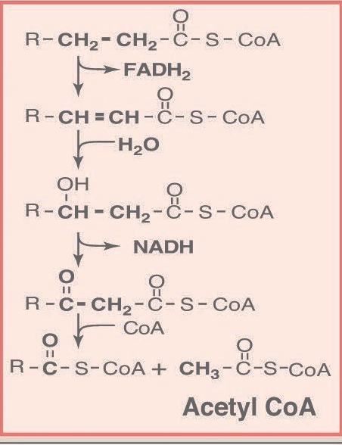
Unsaturated Fatty Acids and Chain Length
In general PUFA/MUFA are oxidized faster
Dehydrogenation step isnt needed
Short/medium chain fatty acids are also oxidized faster
Direct portal transport to liver
SCFA/MCFA do not need carnitine transport
Very long chain fatty acids oxidized in peroxisomes

Slide 18
Calculating Energy Content From Fatty Acids
Steps
Example (C16:1)
Length, subtract 2 and divide by two
Each cycle (14 ATP)
1 NADH (2.5 ATP)
1 FADH (1.5 ATP)
1 Acetyl-CoA (10 ATP)
Add back Acetyl-CoA from last step (10 ATP)
Remove 1.5 ATP per double bond
Remove 2 ATP for activation by ACS
(16-2)/2 = 7
14 x 7 leads to 98
1 leads to 10
1x1.5=1.5ATP -1.5
-2 ATP -2
104.5

Slide 19
Peroxisomal Beta Oxidation
Very long chain fatty acids (>22 C) are selectively oxidized in peroxisomes
Not coupled to ETC
Peroxide generated instead of O2 -> H20
Peroxide removed as catalase (no ATP generated here)
SCFA and MCFA sent to mitochondria
Defects lead to accumulation of VLCFA (Zellweger syndrome)

Slide 20
Zellweger Syndrome
A Peroxisome Biogenesis Disorder (PBD)

Slide 21
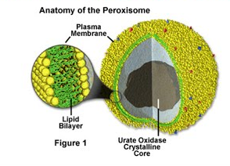
What is ZS?
Autosomal Recessive Disorder
Mutations in the genes that cause the Zellweger spectrum prevent peroxisomes from forming normally. Production is altered, leading to dysfunctionality. They are also important for the production of fats (lipids) used in digestion and in the nervous system.
Peroxins assist in the formation
of peroxisomes by producing the
membrane that separates the
peroxisome from the rest of the
cell and by importing enzymes
into the peroxisome

Slide 22
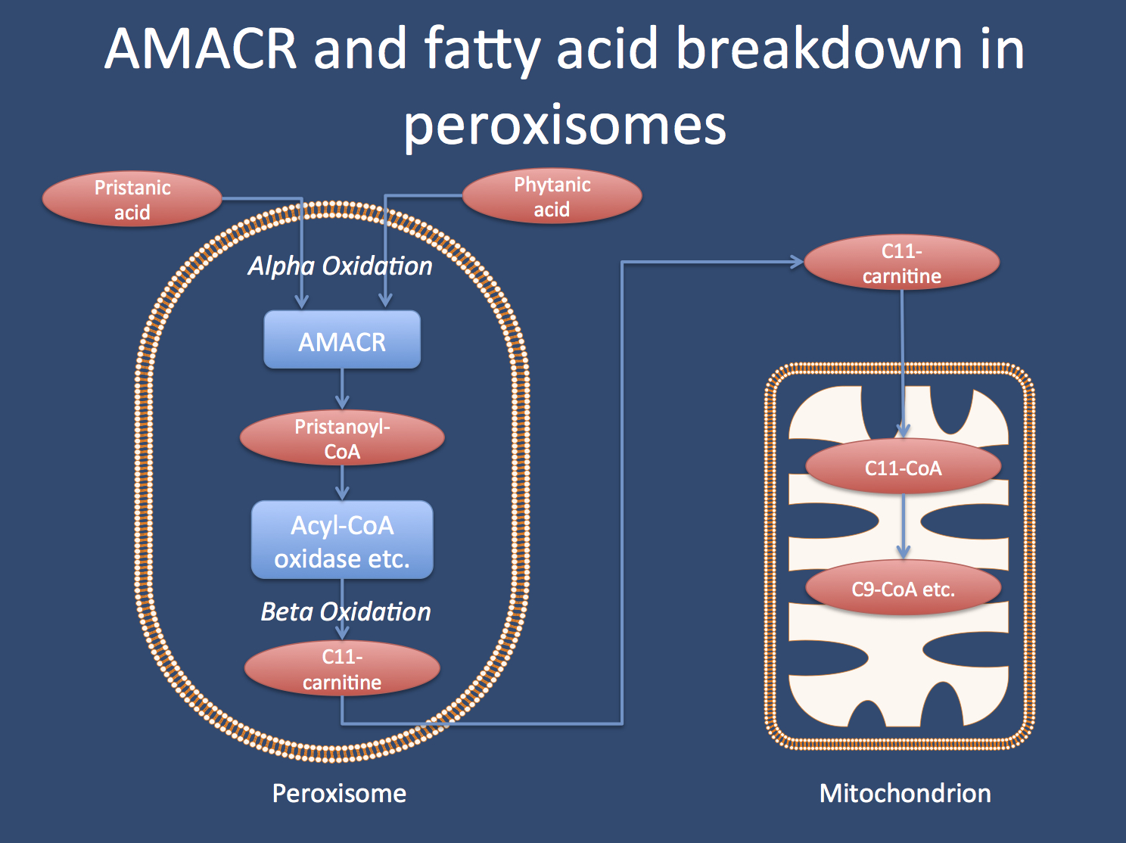

Slide 23
Most Apparent Symptoms
Enlarged liver, characteristic facial features such as a high forehead, underdeveloped eyebrow ridges, and wide-set eyes
Neurological abnormalities such as cognitive impairment and seizures.
Infants with ZS also lack muscle tone, sometimes to the point of being unable to move
May not be able to suck or swallow
Some babies will be born with glaucoma, retinal degeneration, and impaired hearing.

Slide 24
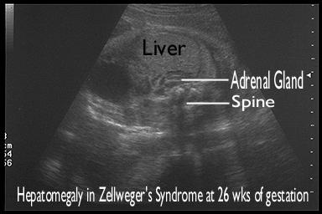
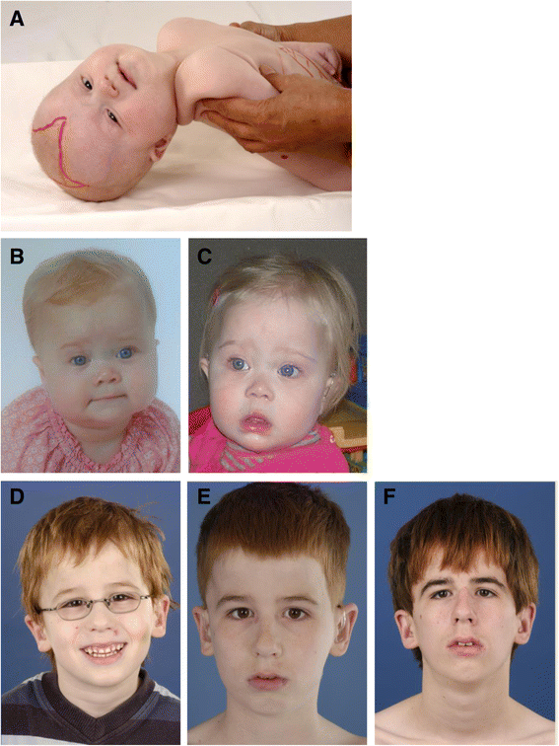
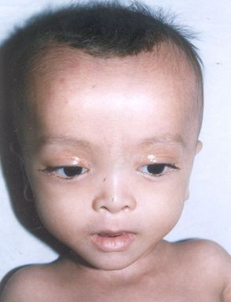

Slide 25
Symptoms & Treatments
Adrenal Insufficiency → Cortisone
Coagulopathy → Vitamin K Supplementation
Epilepsy → Standard Epileptic Drugs
Hearing Impairment → Hearing Aids, Cochlear Implants
High Phytanic Acid Plasma Level → Phytanic Acid Restricted Diet
Low Levels of Fat Soluble Vitamins (A,D,E) → Vitamin Supplementation
Visual Impairment → Cataract Removal, Glasses etc.

Slide 26
Still Confusion about ZSD
The pathophysiology of ZSD is still poorly understood
It is still not clear when or why ZSD patients develop severe rapid progressive leukodystrophy
Can be detected via genetic testing
Diagnosis challenging due to the spectrum of similar disorders

Slide 27
Thank You!
Questions?

Slide 28
Odd-Chained Fatty Acids
Present in ruminant milk
After last cycle there is a three-carbon (Propionyl-CoA) and two-carbon (Acetyl-CoA) left
Propionyl-CoA is converted to the TCA intermediate Succinyl-CoA at a cost of 1 ATP.
This is also true for several amino acids (Val, Ile, Thr, Met)
Dependent on Vitamin B12

Slide 29
Ketone Body Oxidation
Ketone bodies cannot be oxidized in the liver due to the absence of OXCT1
In other tissues beta hydroxybutyrate can be converted to Acetyl-CoA
Produces 1 NADH
2 Acetyl-CoA
Costs 1 GTP to regenerate Succinyl-CoA from Succinate

Slide 30
Concept Map Terms
Chronic Activation of FAO
Acute Activation of FAO
ACC
Carnitine
CPTI
Activated Fatty Acids
Malonyl-CoA
Long Chain Fatty Acids
Very Long Chain Fatty Acids
Short Chain Fatty Acids
Activated Fatty Acids
Regulation of Amino Acid Oxidation
Adrenaline
Insulin
Acyl-CoA Synthase
Activated Fatty Acids
Fatty Acid Synthesis
Energy Stress
Odd Chain Fatty Acids
Lipolysis
GDH
PPARα/δ

Slide 31
Saturated Fat and Chronic Disease Biomarkers
Using atherosclerosis as an example
Wen Zhou

Slide 32
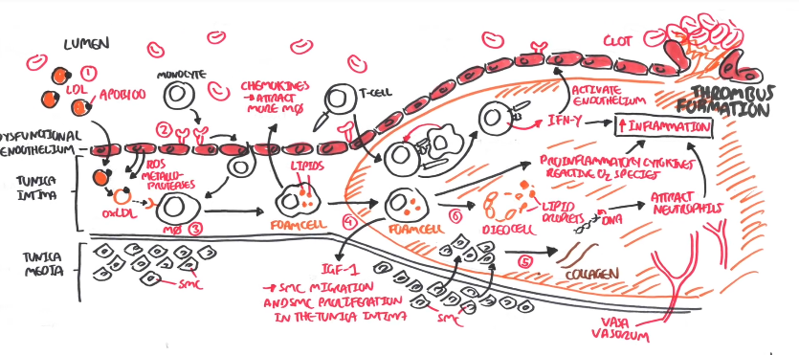
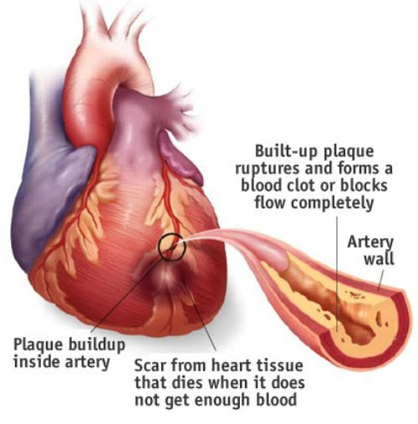
Pathophysiology of Atherosclerosis
https://www.youtube.com/watch?v=R6QTiBfzULE
https://lexingtonbiosciences.com/wp-content/uploads/2016/08/Atherosclerosis.jpg

Slide 33
Pathophysiology of Atherosclerosis
1. Low-density lipoprotein (LDL) particles in blood plasma invade the endothelium releasing cholesterol and become oxidized, activate endothiliol cells.
2. Monocytes enter the artery wall from the bloodstream, differentiate into macrophages, which ingest oxidized LDL, slowly turning into large foam cells.
3. The foam cells promote the migration and proliferation of smooth muscle cells, increasing collegan synthesis (hardening of plaque).
4. Foam cells eventually die, release lipid content and further propagate the inflammatory process.
5. Artery enlarges, ruptures and form blood clot which impede blood flow, leading to heart failure and heart attack.

Slide 34
Atherosclerosis Biomarkers and SFA
Serum LDL cholesterol
HDL (stimulate the removal of cholesterol from cells and transport to liver for excretion)
Triglycerides (carried by VLDL which can enter the arterial wall and stimulate atherosclerosis)
Replacing dietary saturated fat with unsaturated fat decreases LDL
cholesterol levels and triglycerides; increase HDL cholesterol.

Slide 35
SFA and Cadiovascular Diseases
Proved by systematic review and meta-analysis of controlled clinical trials. (These trials compared high saturated with high polyunsaturated fat intake; controlled the dietary intake of the intervention and control groups; had at least 2 years of sustained intake of the assigned diets; proved adherence by objective biomarkers such as serum cholesterol or blood or tissue levels of polyunsaturated fatty acids; and collected and validated information on cardiovascular or coronary disease events.)
Conclusion: Replacement of SFA with PUFA/MUFA reduced CVD by ≈30%. This effect is consistent with the effect of the experimental diet on serum cholesterol.

Slide 36
Controversies
"Saturated fats are not associated with all cause mortality, CVD, CHD, ischemic stroke, or type 2 diabetes, but the evidence is heterogeneous with methodological limitations."
VS
“Meta-analyses of prospective observational studies aiming to determine the effects on CVD of saturated fat that did not take into consideration the replacement macronutrient* have mistakenly concluded that there was no significant effect of saturated fat intake on CVD risk.”
* the replacement macronutrien (unsaturated fatty acids vs. carbonhydrate; refined vs. whole grain)

Slide 37
Daily Intake Recommendation
Decrease intake of saturated fat to 5% to 6% of total daily energy (calorie) intake for individuals with elevated LDL cholesterol concentration.
The 2015 to 2020 Dietary Guidelines for Americans recommend consuming <10% of calories from saturatedfat for the general population (average 11% now)and replacing saturated fat with unsaturated fat.

Slide 38
Reference
Sacks, F. M., Lichtenstein, A. H., Wu, J. H., Appel, L. J., Creager, M. A., Kris-Etherton, P. M., ... & Stone, N. J. (2017). Dietary fats and cardiovascular disease: a presidential advisory from the American Heart Association. Circulation, 136(3), e1-e23.
Atherosclerosis Pathophysiology (vedio file). Accessed from: https://www.youtube.com/watch?v=R6QTiBfzULE
Mensink, R. P., & World Health Organization. (2016). Effects of saturated fatty acids on serum lipids and lipoproteins: a systematic review and regression analysis.
Atherosclerosis. Wikipedia. Accessed from: https://en.wikipedia.org/wiki/Atherosclerosis#Cellular

Slide 39
Learning Objectives
Explain how triglyceride breakdown into glycerol and free fatty acids is controlled in adipocytes by hormonal signals.
Explain how high carbohydrate diets affect fuel utilization, including effects on lipid fuel utilization. Describe at an endocrine level how this is thought to occur.
Determine how much energy, in ATP equivalents, is released during the oxidation of a given fatty acid. Be able to relate the energy content of a fatty acid, in general to its physical properties (length and saturation).
Explain the rate limiting steps of lipid oxidation.
Explain how ketone bodies are converted to ATP in non-hepatic tissues, and what governs this specificity.
Demonstrate an understanding of how how de novo lipogenesis and b-oxidation are reciprocately controlled.
Describe how very long chain fatty acids are oxidized differently from long chain fatty acids.
Explain how odd-numbered fatty acids are catabolized, including the importance of vitamin B12 in this process.
Evaluate the role of transcriptional regulation and long term adaptations to fatty acid oxidative capacity.

